Slide 1

Web scraping and exploratory data analysis
12/03/2024

Slide 2
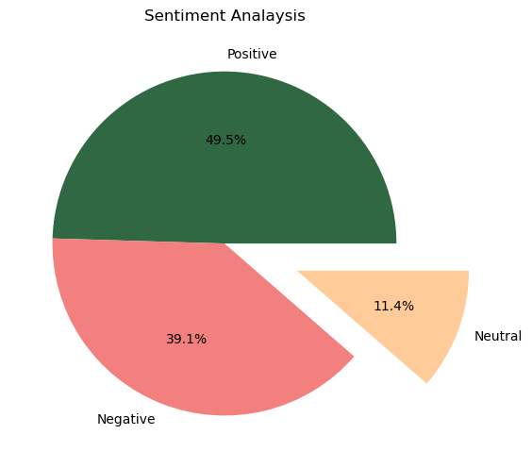
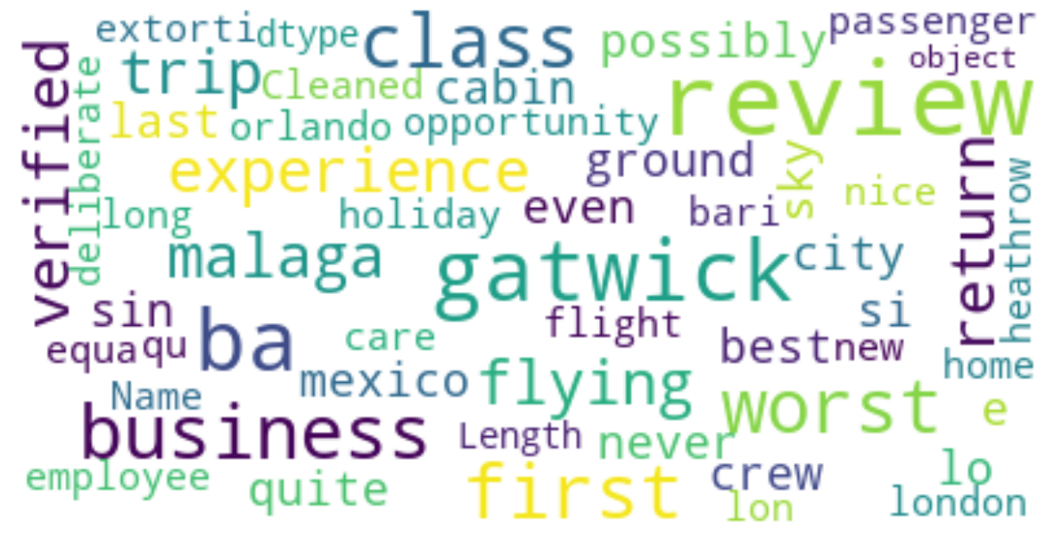
SENTIMENT ANALYSIS AND WORCLOUD
Keywords used in reviews
Sentiment Analysis Review
Positive reviews - 743
Negative reviews - 586
Neutral reviews - 171

